Slide 1
DISCRETE MATHEMATICS PROJECT
SUBMITTED BY:
AHMAD SAJJAD (2023-CS-81)
ABDUL REHMAN (2023-CS-73)

Slide 2
CONTENT
GRAPH THEORY
NUMBER THEORY

Slide 3
INDIVIDUAL CONTRIBUTION and project planning:
Individual Contribution:
The coding problems of number theory and slides for presentation were made by AHMAD SAJJAD (2023-CS-81).
The theoretical questions and coding problems of graph theory were made by ABDUL-REHMAN (2023-CS-73).
PROJECT PLANNING:
In project planning, first we divided the whole project into two parts number theory and graph theory. For solving coding problem, we choose C++ language as we learnt and programmed in it in 1st semester and have good grip and practice in it. And for games section we studied those games which we had played and knew that graph is used in this game.

Slide 4
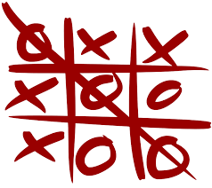
Game analysis
TIC-TAC-TOE GAME graphical representation
Tic-tac-toe, also known as noughts and crosses or Xs and Os, can be analysed using graph theory. Graph theory is a branch of mathematics that studies relationships between objects, and in this context, we can represent the possible states and moves of a tic-tac-toe game as a graph.
Vertices (Nodes):
Each possible state of the tic-tac-toe board can be represented as a node. This includes all the different ways Xs and Os can be arranged on the board.
Edges (Links):
The edges between nodes represent legal moves from one state to another. For tic-tac-toe, an edge connects two states if the second state can be reached by making a legal move from the first state.

Slide 5
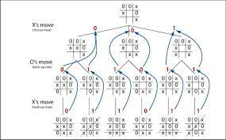
Game Tree:
The graph for tic-tac-toe is essentially a game tree, where each node represents a game state, and edges represent possible moves. The root of the tree is the initial state of the board, and the leaves are terminal states (win, lose, or draw).
Terminal Nodes:
Terminal nodes in the graph are those representing game states where the game is over (win, lose, or draw). These nodes have no outgoing edges.

Slide 6
Game analysis
To achieve
A winning path in the graph is a sequence of edges from the root to a terminal node representing a win. These paths show the sequence of moves that lead to a win for one of the players.
To avoid
Players aim to avoid suboptimal moves by using graph theory to identify the best possible moves in different situations. This minimizes the risk of losing.
Understanding the graph helps players avoid putting themselves in unfavorable positions that could lead to a loss.

Slide 7
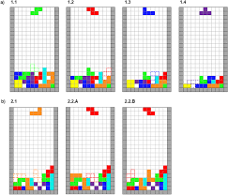
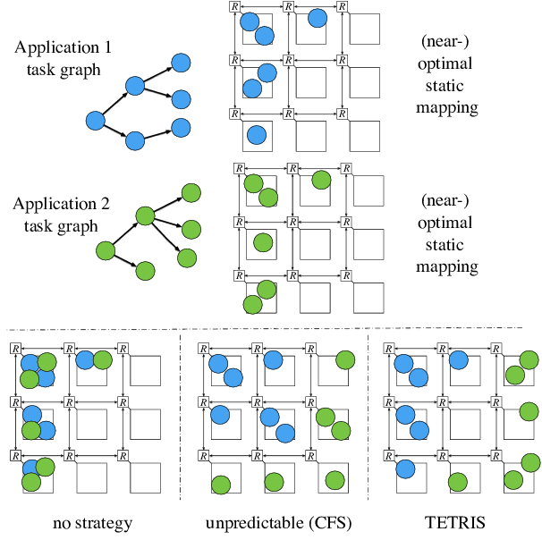
Game analysis
TETRIS GAME graphical representation:
Tetris involves representing the game state, movements, and interactions using graph structures. Tetris is a classic block-stacking game where the player manipulates falling shapes (tetrominos) to create complete lines.
Graph Nodes:
Each node in the graph represents a possible game state. This includes the position and orientation of the falling tetromino, as well as the existing blocks on the board.
Graph Edges:
Edges between nodes represent possible movements of the tetromino or the passage of time (i.e., the falling of the tetromino).
Nodes are connected by edges when a legal move is made. For example, moving the tetromino left or right, rotating it, or letting it fall one row down.
Game State:
The game state includes the current position, orientation, and shape of the falling tetromino, as well as the layout of the existing blocks on the board.
Actions:
Nodes are connected by edges to represent legal moves. Actions include moving the tetromino left or right, rotating it, and letting it fall one row down.
Constraints:
Edges between nodes need to consider constraints such as collision detection with existing blocks, the boundaries of the playfield, and the ability to rotate the tetromino without conflicts.

Slide 8
Game analysis
Goal
The goal state is achieved when complete lines are formed, and they are cleared. This could be represented as a specific configuration or state in the graph. Each node in the graph represents a potential state of the game, and edges represent valid moves between these states. The player's actions (e.g., rotating, moving left or right) determine the transitions between nodes.

Slide 9
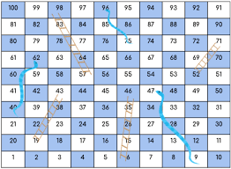
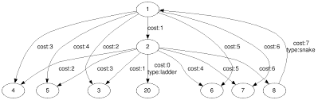
Game analysis
SNAKES AND LADDERS graphical representation
Snakes and Ladders is a classic board game played on a square grid. The game is often used as an analogy in graph theory to explain concepts like directed graphs, nodes, and edges. In this context, each square on the board represents a node in the graph, and the ladders and snakes represent edges or transitions between nodes.
Nodes (Vertices):
Each square on the board is a node in the graph. The number of nodes depends on the size of the board.
Edges (Connections):
The ladders and snakes represent the edges between nodes. Each ladder creates a direct edge from the bottom of the ladder to the top, while each snake creates an edge from the head of the snake to its tail.
Directed Graph:
The graph is typically a directed graph since moving up a ladder is different from moving down a snake. If you roll the dice and move up a ladder, you don't have the option to go back down that ladder in the same turn.
Scores:
You can assign weights to the edges to represent the number of squares you move when you encounter a ladder or a snake.

Slide 10
Game analysis
Achieve in Game
The primary objective is to reach the finish node (last square) from the starting node using the available edges (rolls of the dice).
Avoid in Game
Staying at the start or getting stuck in loops that prevent reaching the finish.

Slide 11
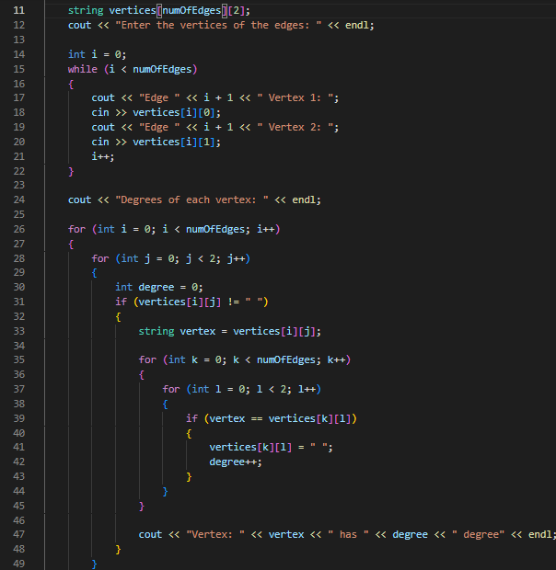
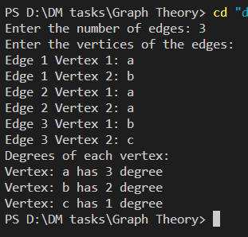
Graph THEORY
Undirected Graph Degrees:
Input for number of edges is taken then for each
Edge vertices are taken. The number of edges a vertex
Is connected to is its degree.
Example Output:

Slide 12
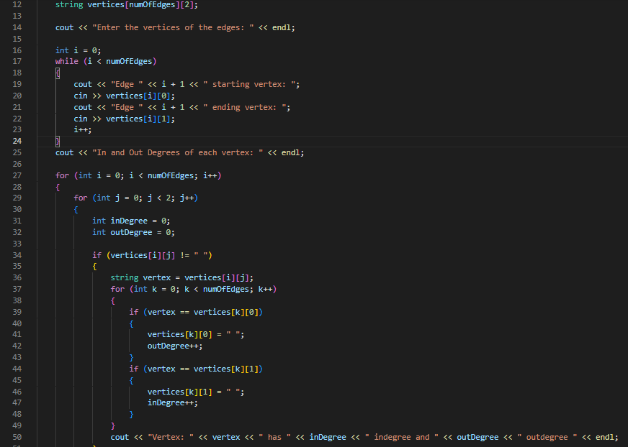
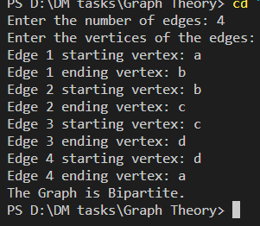
Graph THEORY
Directed Graph Degrees:
Input for number of edges is taken then head
And tail vertex is taken as input for each edge.
If a vertex is found at a tail its outdegree increments
And If found at head its indegree increments.
Example Output:

Slide 13
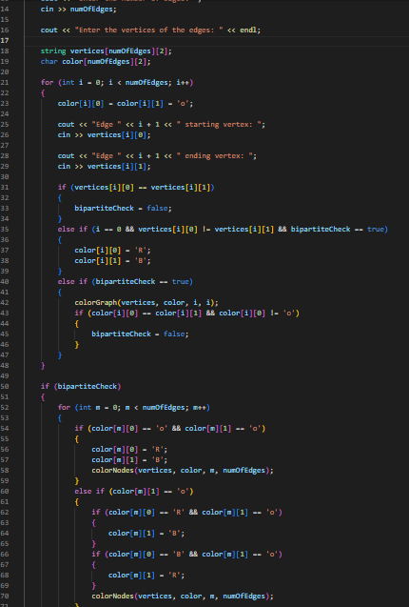
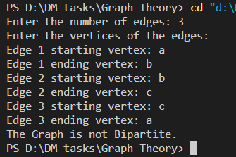
Graph THEORY
Bipartite Graph Check:
A graph is called bipartite if all adjacent vertices do
not have same colour. First number of edges are given
then pair of vertices for each edge are given and all are
Given colour if two same colour vertices found graph is
Not bipartite.
Example Output:

Slide 14
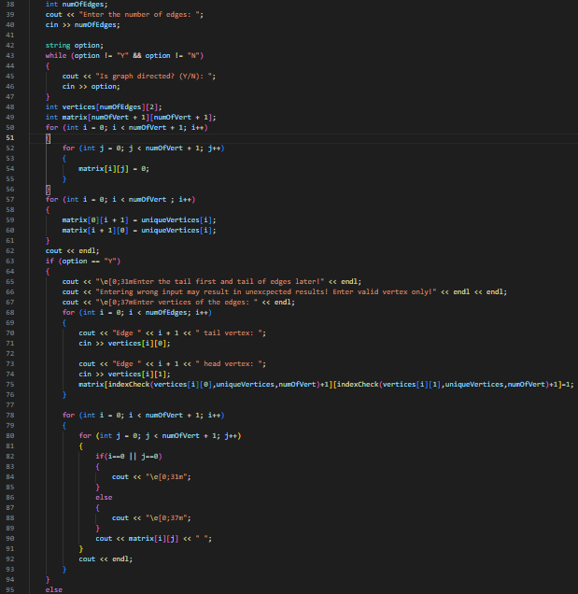
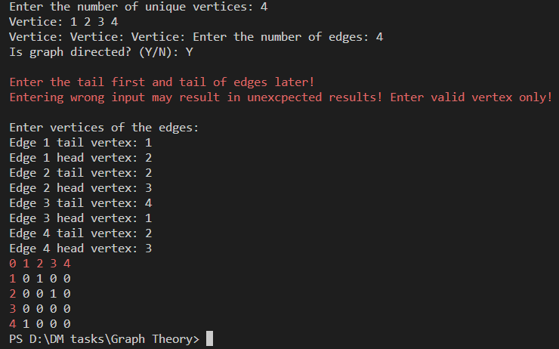
Graph THEORY
Adjacency Matrix Creation:
In this program first number of vertices is
taken as input then unique vertices are taken
and nature of graph is asked on the basis
of which adjacency matrix of is displayed.
Example Output:

Slide 15
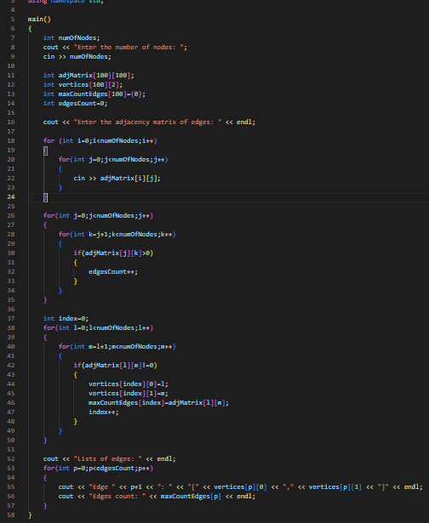
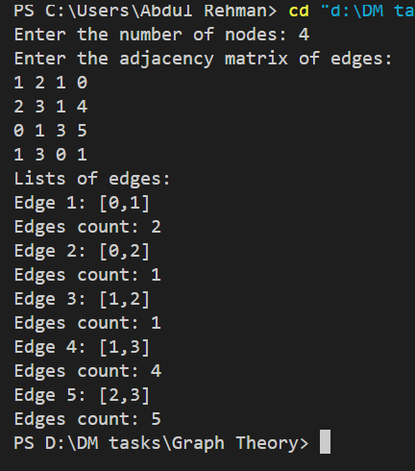
Graph THEORY
Edge Listing from Adjacency Matrix:
In this program first number of vertices is
taken as input which determines the matrix size.
Then adjacency matrix of nodes is taken and
program processes these and displays the
edges and their frequency.
Example Output:

Slide 16
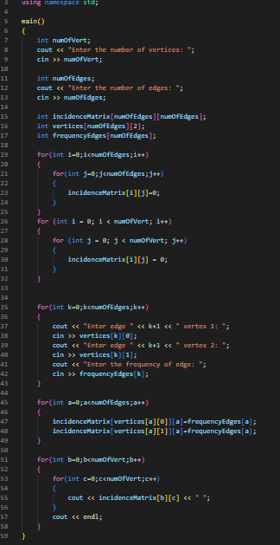
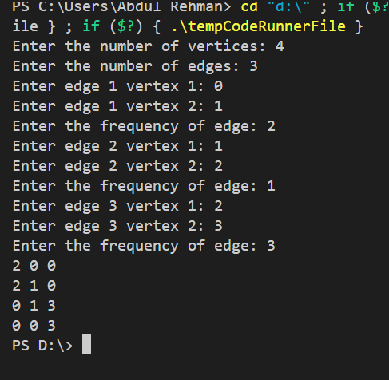
Graph THEORY
Incidence Matrix Construction:
In this program first number of vertices is taken as
input which determines the matrix size. Then vertices
and frequency of edges are taken as input and the
Program processes these and displays an incidence
Matrix.
Example Output:

